Slide 1
ANZdata
File created on: 2020-11-01 22:28:51

Slide 2
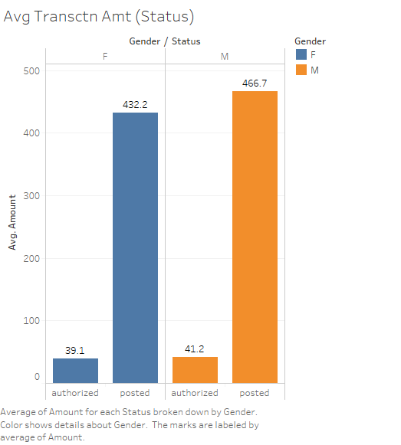

Slide 3
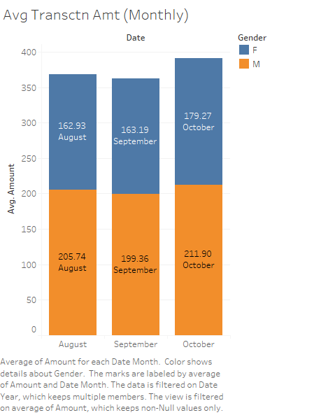

Slide 4
